Slide 1
1
Define Problem Zone
Solution
Parametric
Linear Regression
Problem
Univariate
Non-parametric
KNN, RF, DT, SVM
Regression (Continues Output)
Parametric
Polynomial Regression
Multivariate
Non-parametric
KNN, RF, DT, SVM
Supervised Learning
Parametric
Logistic Regression
Binary-class
Non-parametric
KNN, RF, DT, SVM
Classification (Discrete Output)
Parametric
MLP
Multi-class
Non-parametric
KNN, RF, DT, SVM

Slide 2


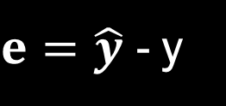





2
Solution Model
Linear Regression
Parametric solution
Y
y = m x + b
k
x
y
e4
500
$$\hat{y}$$
e5
y = w₀ + w₁ x ---> (1)
y
Area | Price (k)
100 | 200
150 | 400
200 | 450
250 | 550
300 | 450
e3
400
$$\hat{y}$$
e2
Error
300
$$\hat{y}$$
$e=\hat{y}$ - y
e1
200
$$e1+e2+e3+e4+e5$$
100
$E=\sum_{i=1}^{n}{\text{(}\hat{y}\text{ −} \text{y}\text{) }→(2)}$
X
50
50
50
100
100
150
150
150
200
200
200
250
$$m^{2}$$
250
300

Slide 3
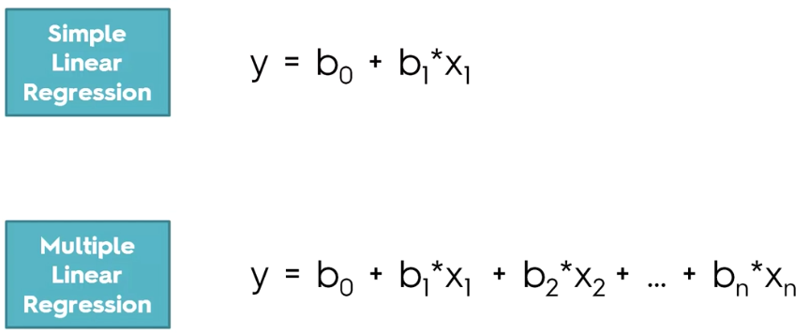

Slide 4
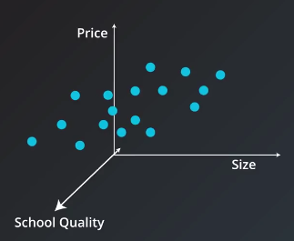
2
Solution Model
Linear Regression
x1
x2
y
y = w₀ x₀ + w₁ x₁ + w₂ x₂
Area | Num of Rooms | Price (k)
100 | 2 | 200
150 | 3 | 400
200 | 4 | 450
250 | 5 | 550
300 | 7 | 450
Num of Rooms

Slide 5


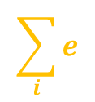
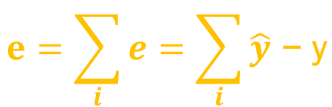

2
Solution Model
Linear Regression
y = w₀ x₀ + w₁ x₁ + w₂ x₂
Y
w₀
w₁
w₂
e3
$$\sum_{i}{e}$$
e2
e1
$$\hat{y}$$
y
$$\hat{y}$$
y
$$\hat{y}$$
y
X
$$e=\sum_{i}{e}=\sum_{i}{\hat{y}\text{ − }\text{y}}$$

Slide 6
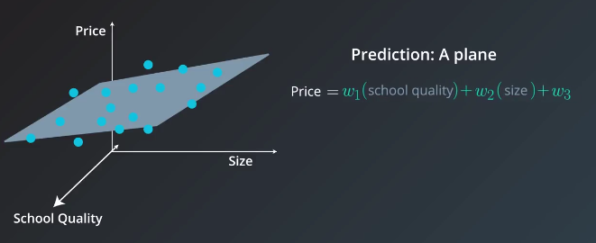

Slide 7
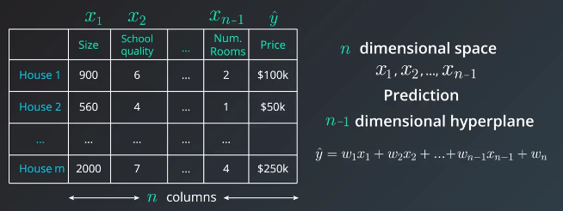

Slide 8
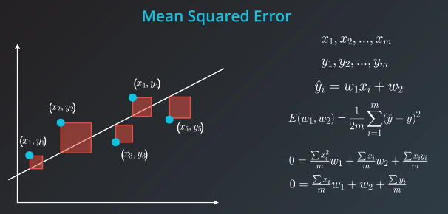

Slide 9
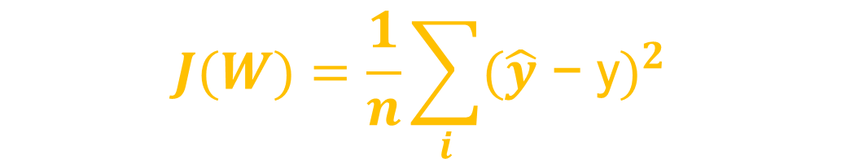
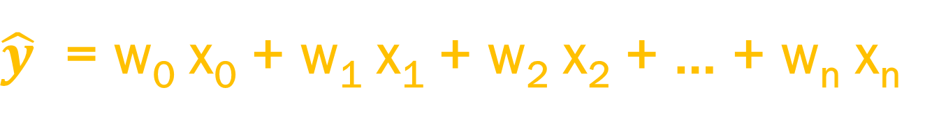
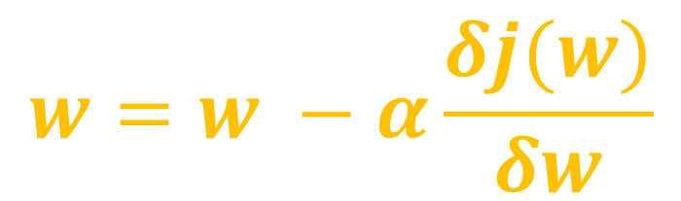
$\hat{y}$ = w₀ x₀ + w₁ x₁ + w₂ x₂ + … + w_{n} x_{n}
Linear Model
$$J(W)=\frac{1}{n}\sum_{i}{{(\hat{y}\text{ − }\text{y})}^{2}}$$
Cost Function
$$w=w −α\frac{δj(w)}{δw}$$
Gradient Descent

Slide 10
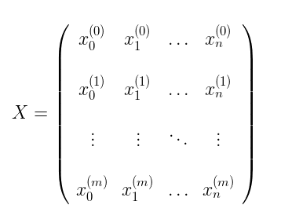
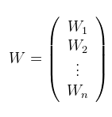
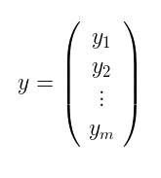

Slide 11
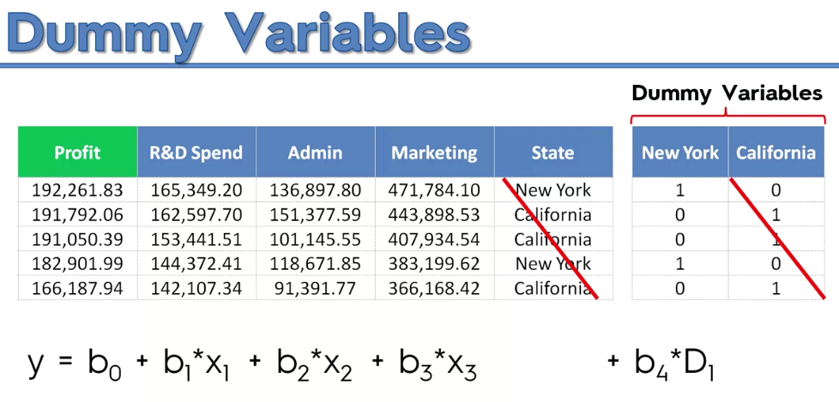

Slide 12
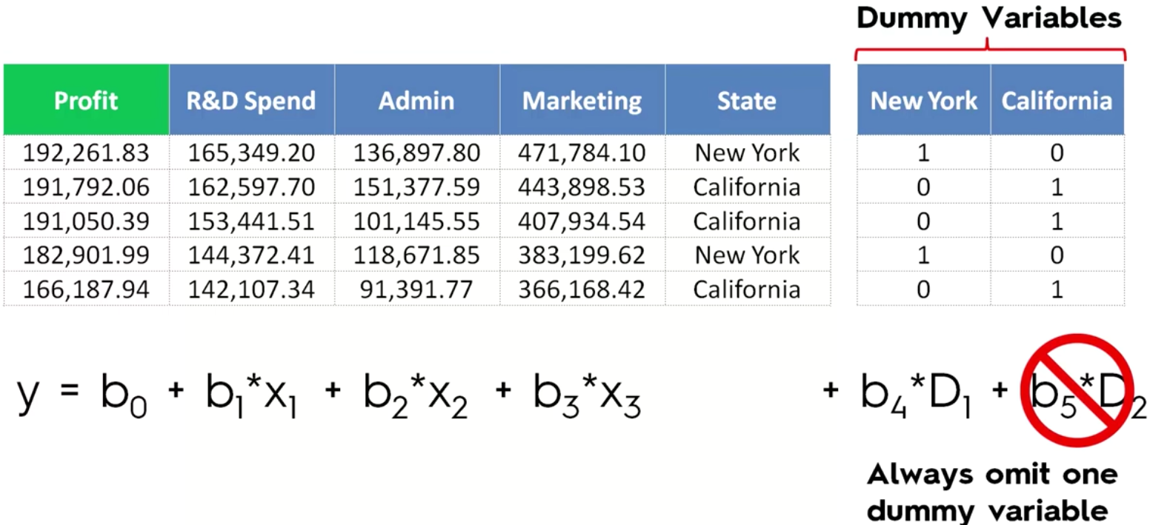

Slide 13
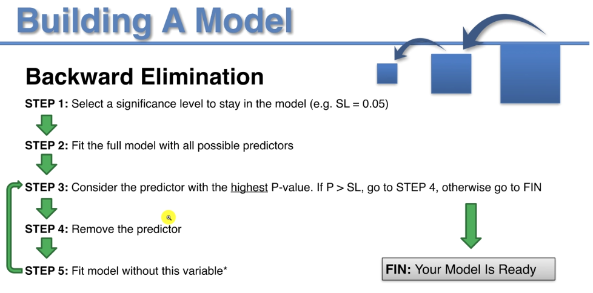

Slide 14
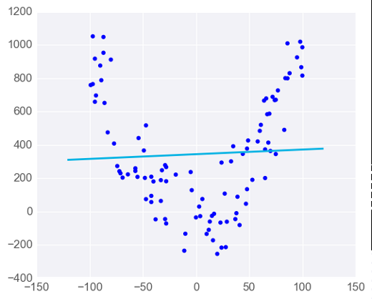
Linear Regression Warnings
Linear Regression Works Best When the Data is Linear

Slide 15
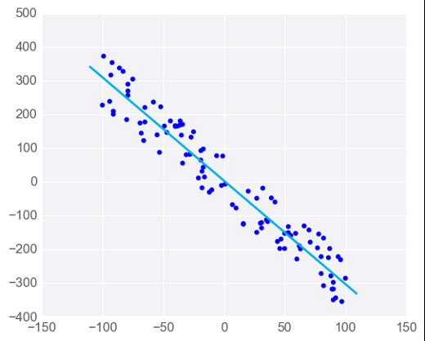
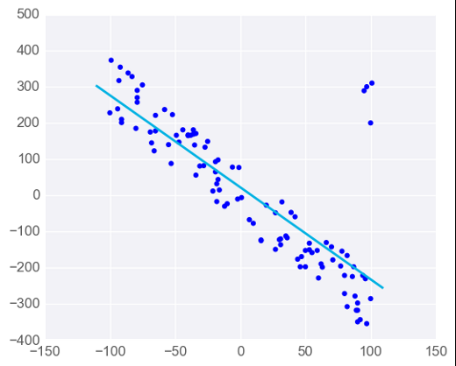
Linear Regression Warnings
Linear Regression is Sensitive to Outliers

